Slide 1
BLM1612 - Circuit Theory
Prof. Dr. Nizamettin AYDIN
naydin@yildiz.edu.tr
The Single-Loop Circuit
The Single-Node-Pair Circuit
Series Circuits
Parallel Circuits

Slide 2
Objectives of the Lecture
Explain mathematically how resistors in series are combined and their equivalent resistance.
Explain mathematically how resistors in parallel are combined and their equivalent resistance.
Rewrite the equations for conductances.
Explain mathematically how a voltage that is applied to resistors in series is distributed among the resistors.
Explain mathematically how a current that enters the a node shared by resistors in parallel is distributed among the resistors.

Slide 3
The Single-Loop Circuit
First step in the analysis is the assumption of reference directions for the unknown currents.
Second step in the analysis is a choice of the voltage reference for each of the two resistors.
The third step is the application of Kirchhoff’s voltage law to the only closed path.

Slide 4
Conservation of Energy
The sum of the absorbed power for each element of a circuit is zero.
The sum of the absorbed power equals the sum of the supplied power

Slide 5
Example-01
Compute the power absorbed in each element for the circuit shown in the Figure.
power absorbed by each element:

Slide 6
Example-02
Find the power absorbed by each of the five elements in the circuit.
power absorbed by each element:

Slide 7
The Single-Node-Pair Circuit
KVL forces us to recognize that the voltage across each branch is the same as that across any other branch.
Elements in a circuit having a common voltage across them are said to be connected in parallel.

Slide 8
Example-03
Find the voltage, current, and power associated with each element in the following circuit.
power absorbed by each element:
Supplying power
Absorbing power

Slide 9
Example-04
Determine the value of v and the power absorbed by the independent current source in the circuit.
Actually 345.6 mW is supplied

Slide 10
Example-05
For the single-node-pair circuit, find i_{A} , i_{B} and i_{C} .
5.6 = i_{A} + i_{B} + i_{C} + 2 = 3 – 5.4 + 6 + 2 = 5.6

Slide 11
Series Circuits
Series
all elements in a circuit (loop) that carry the same current
The 60 V source and the 8 Ω resistor are in series.
The 8 Ω resistor and 4 Ω resistor are not in series.

Slide 12
Series Circuits
R₃ is in series with the 36 V source.
R₄, the 14 V element, the v₂ element, the v_{s1} source, and R₁ are in series.
No element is in series with R₂.

Slide 13
Parallel Circuits
Parallel
all elements in a circuit that have a common voltage across them (elements that share the same 2 nodes)
The 120 A source, 1/30 Ω resistor, 30 A source, and 1/15 Ω resistor are in parallel.

Slide 14
Parallel Circuits
The current source and the 2 Ω resistor are in parallel.
No other single elements are in parallel with each other.
The 60 V source and 8 Ω resistor branch is in parallel with the 10 Ω resistor.

Slide 15
Example-06
In the following circuit;
which individual elements are in series/in parallel?
which groups of elements are in series/in parallel?

Slide 16
Example-07
In the following circuit;
which individual elements are in series/in parallel?
which groups of elements are in series/in parallel?

Slide 17
Example-08
In the following circuit;
which individual elements are in series/in parallel?
which groups of elements are in series/in parallel?

Slide 18
Voltage Sources in Series
can replace voltage sources in series with a single equivalent source
all other voltage, current, & power relationships in the circuit remain unchanged
might greatly simplify analysis of an otherwise complicated circuit

Slide 19
Voltage Sources in Series
The connection of batteries in series to obtain a higher voltage is common in much of today’s portable electronic equipment.
Four 1.5V AAA batteries have been connected in series to obtain a source voltage of 6V.
The voltage has increased, but the maximum current for each AAA battery and for the 6V supply is the same.
The power available has increased by a factor of 4 due to the increase in terminal voltage.

Slide 20
Example-09
The current and the power consumed by the resistors is the same in (a,b,c).
However, the voltage sources must be broken out from the equivalent to solve for their individual powers delivered.

Slide 21
Voltage Sources in Parallel
Unless v₁ = v₂ = …, this circuit is not valid for ideal sources.
All real voltage sources have internal resistance and are usually not exactly equal.
Current will flow from the higher source to the lower source until equilibrium is reached (e.g. dangerously).
Properly designed, a bank of equal voltage sources can deliver many times the current of a single source.

Slide 22
Current Sources in Parallel
can replace current sources in parallel with a single equivalent source
all other voltage, current, & power relationships in the circuit remain unchanged
as with voltage sources, this technique may simplify circuit analyses

Slide 23
Example-10

Slide 24
Resistors in Series
As with voltage/current sources, resistors may also be replaced with equivalents.
In series, resistances are added.
the total resistance of series resistors is always larger than the value of the largest resistor.

Slide 25
Resistors in Series
It is important to realize that when a dc supply is connected, it does not see the individual connection of elements but simply the total resistance seen at the connection terminals
Resistance seen at the terminals of a series circuit:

Slide 26
Resistors in Series
The total resistance of any configuration can be measured by simply connecting an ohmmeter across the access terminals as shown below.
Since there is no polarity associated with resistance, either lead can be connected to point a, with the other lead connected to point b.

Slide 27
Power Distribution in Series Circuit
For any network composed of resistive elements, the power applied by the battery will equal that dissipated by the resistive elements
For R₁
In a series resistive network, the larger the resistor, the more the power absorbed.

Slide 28
Resistors in Parallel
For resistors in parallel, the reciprocals of the resistances sum to 1 / (the equivalent).
the total resistance of parallel resistors is always less than the value of the smallest resistor.

Slide 29
Resistors in Parallel
The total resistance of any configuration can be measured by simply connecting an ohmmeter across the access terminals as shown below.
There is no polarity to resistance, so either lead of the ohmmeter can be connected to either side of the network.
Always keep in mind that ohmmeters can never be applied to a live circuit.

Slide 30
Power Distribution in Parallel Circuit
For any network composed of resistive elements, the power applied by the battery will equal that dissipated by the resistive elements
For R₁
In a parallel resistive network, the larger the resistor, the less the power absorbed.

Slide 31
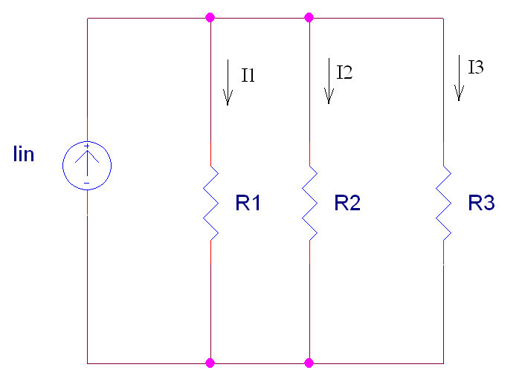
Symbol for Parallel Resistors
To make writing equations simpler, we use a symbol to indicate that a certain set of resistors are in parallel.
Here, we would write
R1║R2║R3
to show that R1 is in parallel with R2 and R3.
This also means that we should use the equation for equivalent resistance if this symbol is included in a mathematical equation.

Slide 32
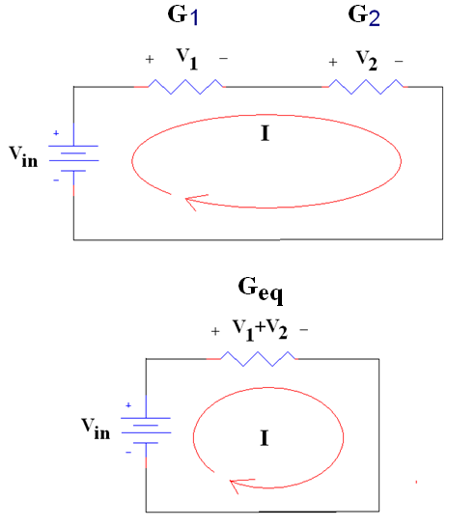
If G is used instead of R
In series:
The reciprocal of the equivalent conductance is equal to the sum of the reciprocal of each of the conductors in series
In this example
1/G_{eq} = 1/G₁ + 1/G₂
Simplifying
(only for 2 conductors in series)
G_{eq} = G₁G₂ /(G₁ + G₂)

Slide 33
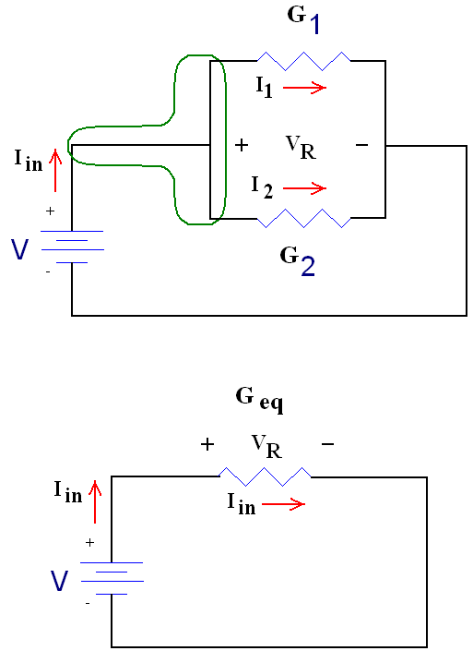
If G is used instead of R
In parallel :
The equivalent conductance is equal to the sum of all of the conductors in parallel
In this example
G_{eq} = G₁ + G₂

Slide 34
Example-11
Use resistance and source combinations to determine the
current i and the power delivered by the 80 V source in this circuit .
Actually 240 W is supplied

Slide 35
Example-12
Determine v in this circuit by first combining
the three current sources, and then the two 10 ohm resistors.

Slide 36
For the same value resistors
As you increase the number of resistors in series
Does R_{eq} increases or decreases?
As you increase the number of resistors in parallel
Does R_{eq} increases or decreases?

Slide 37
Summary

